Slide 1
Simple constant amortized time generation of fixed length numeric partitions
John M. Boyer
Journal of Algorithms 54 (2005) 31-39
Presenter: Yung-Hsing Peng
Date: 2005.09.23

Slide 2
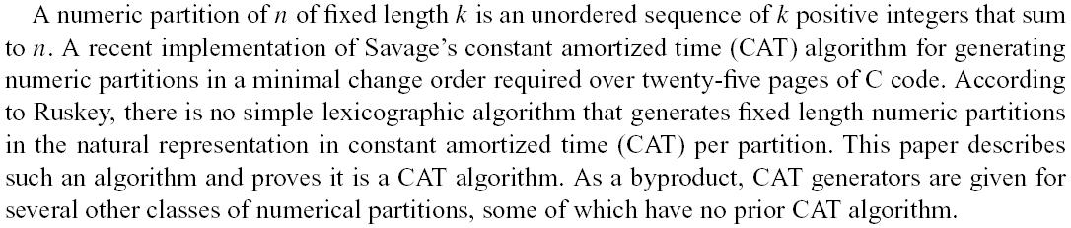
Abstract

Slide 3
Numeric Partition Problem
Input Description: A positive integer n, and a fixed length k
Problem: Find all numeric partitions to partition n into k groups
Savage proposed the first CAT algorithm[8] to find them in constant time per partition (in minimal changed order). However, the implementation[1] takes at least 25 pages of C code.
The author proves that finding each partition in lexical order also achieves the CAT performance (proof by induction). → very simple and fast

Slide 4
Example for P(12,6) (1/2)
Given n=12, k=6, the partitions can be listed in lexical order
(1, 1, 1, 1, 1, 7), (1, 1, 1, 1, 2, 6), (1, 1, 1, 1, 3, 5), (1, 1, 1, 1, 4, 4)
(1, 1, 1, 2, 2, 5), (1, 1, 1, 2, 3, 4), (1, 1, 1, 3, 3, 3), (1, 1, 2, 2, 2, 4)
(1, 1, 2, 2, 3, 3), (1, 2, 2, 2, 2, 3), (2, 2, 2, 2, 2, 2)

Slide 5
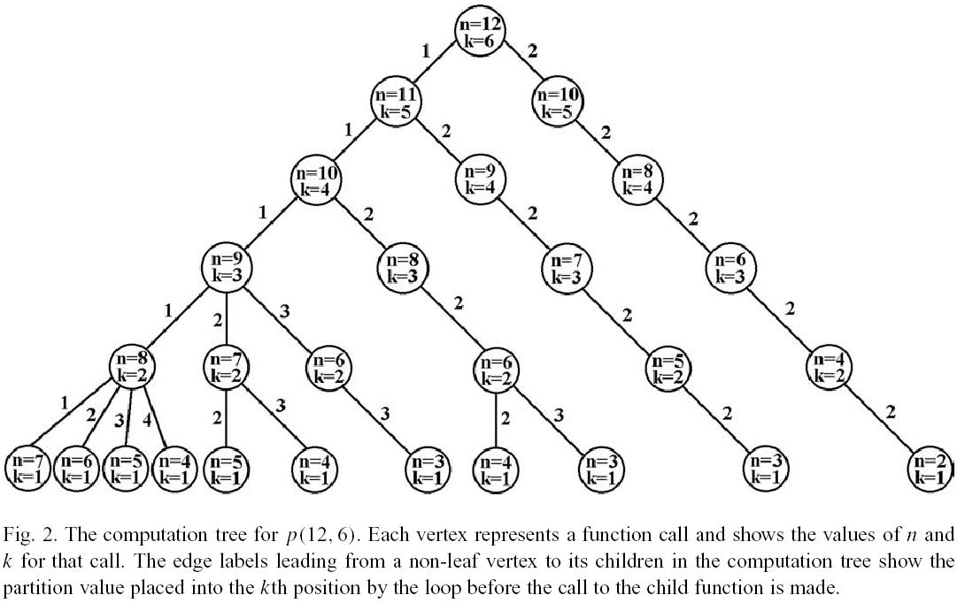
Example for P(12,6) (2/2)

Slide 6
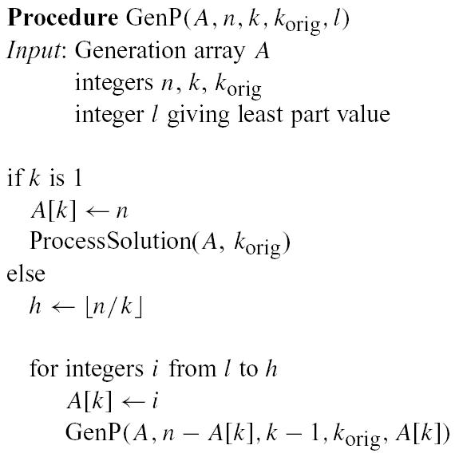
Main Procedure

Slide 7
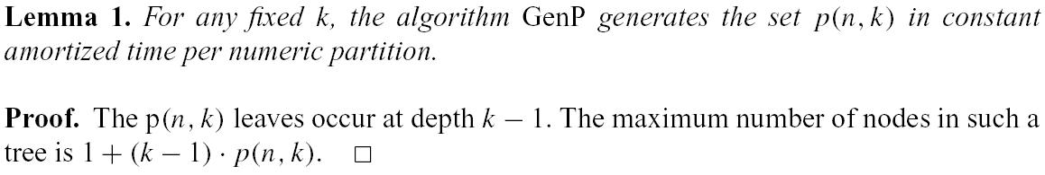
Things to prove
To prove Theorem 2, what we need to do is to analyze the number of nodes, and its relation with p(n,k). Here we need additional term k² – n²/4 to make the inductive step.
→ This can be achieved by discussing three cases.

Slide 8
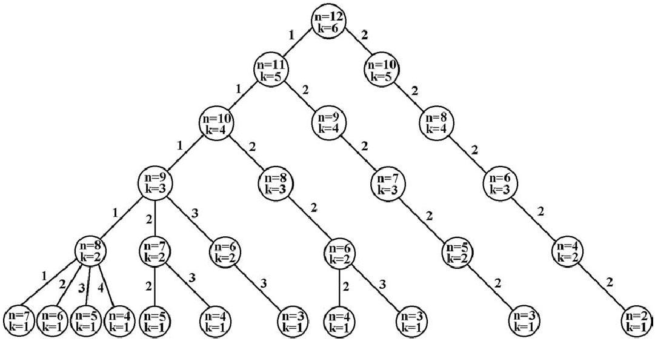
Computation tree for case I
Computation tree for k = n/2

Slide 9
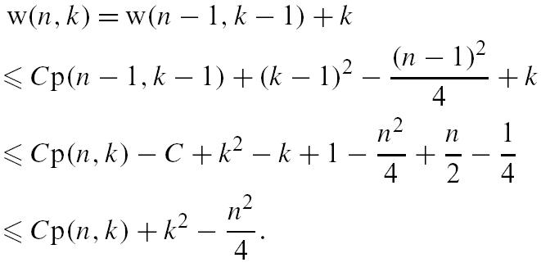
Case I (2/2)
The equation above can be understood as conquering the rightmost path.

Slide 10
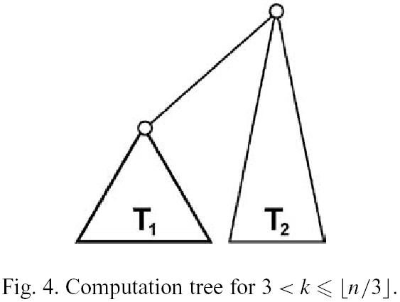
Case II (1/2)
In this case, we can shift T₂ to w(n – k, k)

Slide 11
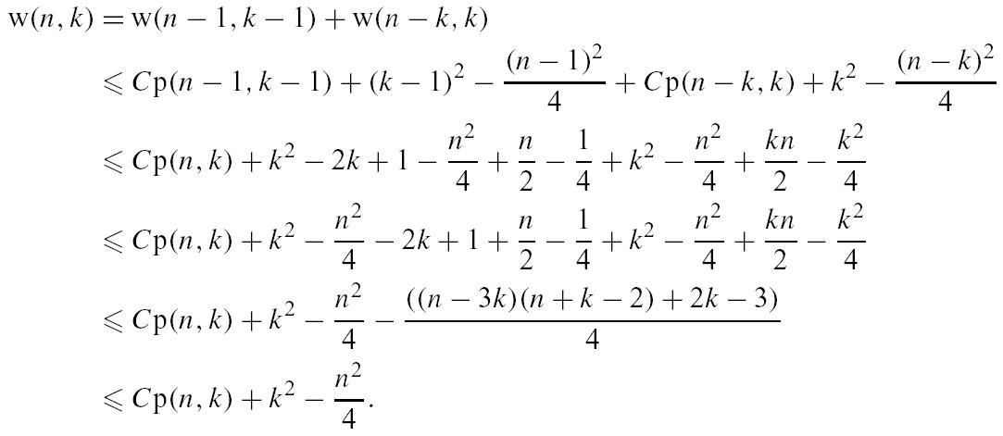
Case II (2/2)
The equation above can be understood as breaking T to T₁ and T₂.

Slide 12
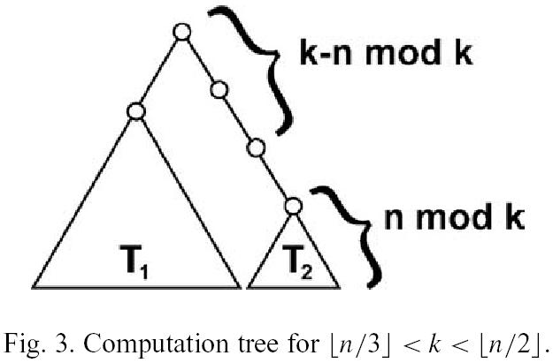
Case III (1/2)
In this case, n – 2k = n mod k, therefore k – (n mod k) equals to 3k – n
The number to be partitioned on the root of T₂ is n – 2(k – (n mod k))
We can shift T₂ to w(n – 2(k – (n mod k) – n mod k, n mod k) → w(2(n-2k), n-2k)

Slide 13
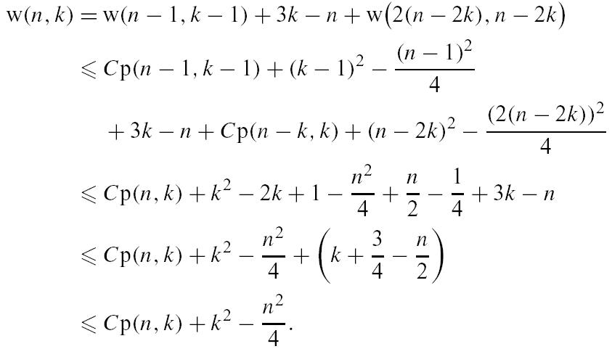
Case III (2/2)
The equation above can be understood as breaking T to T₁ and T₂, along with conquering the path to T₂.

Slide 14
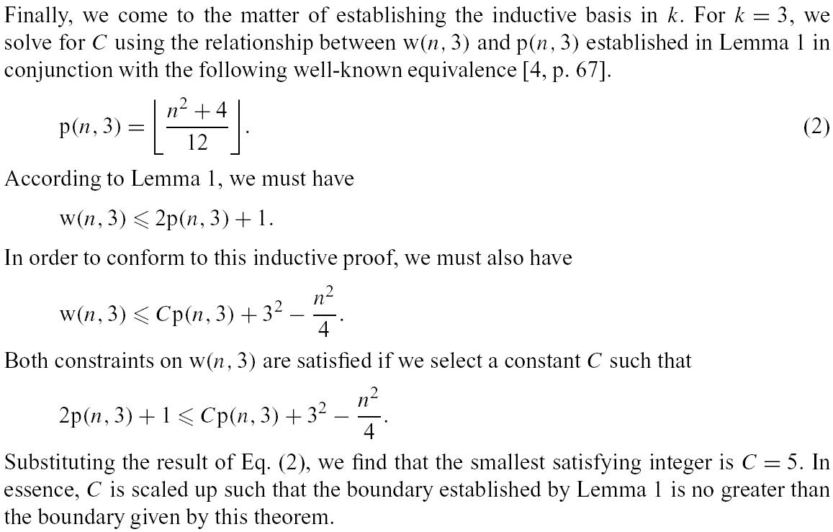
Inductive Basis

Slide 15
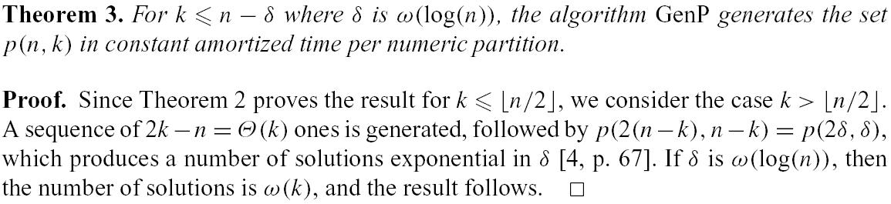
Conclusion
By modifying this algorithm, we can easily obtain the CAT algorithm for odd partition, even partition and distinct partition.

Slide 16
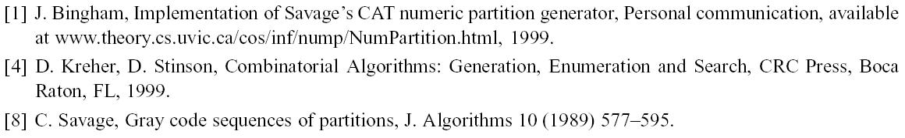
Reference

